Slide 1
Final Project Part 2: Project Presentation
Around the World in Video Games: The Importance of Region and Country in League of Legends

Slide 2
By: Zachary Gonzalez

Slide 3
Abstract
This study aims to determine whether the origin of a team is significant for their success in League of Legends. This hypothesis comes from the historical data that South Korea has dominated on the world stage with 6 of the last 10 wins and the next closest country being China with only 2.
The models used for prediction and analysis are a mixture of Logistic and Random Forrest Classification.
With the analysis done it can be concluded that the country and region of a team has very little to no effect on the teams success. However, even though they don’t have a significant effect changes in data can be observed between regions. This comes in the form of what is more important to focus on during games, this can be seen in the feature selection for the models.
*Please add slides as required.

Slide 4
Introduction
Plan of attack
Logistic Regression
Country and Region only
Check against specific countries/regions and lanes
RFC Feature Selection
Choose 10 best overall features from:
All 3 regions + the Pangea data frame will be used
Logistic Regression And Cross Validation
Data frame with 10 best features and Country/Region
Data frame with 10 best features
*Please add slides as required.

Slide 5
The Problem (Context)
What is being solved?
The problem in question is whether or not region and country is a significant factor in a teams ability to succeed.
Why?
Solving this problem offers insight into what makes an e-sport team competitive. Using this information can change the way an organization decides to prepare for a season and using current data they could adapt their playstyle to fit another's.
*Please add slides as required.

Slide 6
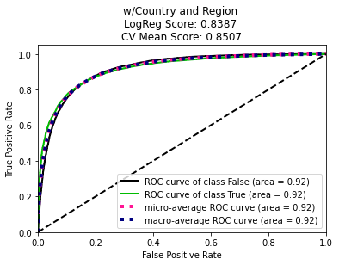
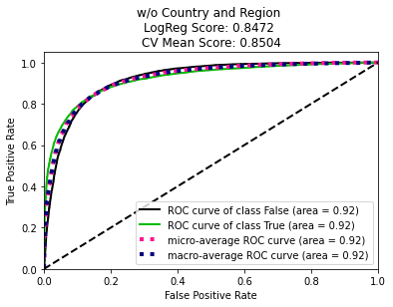
Purpose of the Study
What I’m hoping to find from this study is that the origin of a team is not significant. But I am hoping to see signs of separated patterns between regions that could offer insight into why some teams perform better globally.
Conclusively, I have found that the origin is in fact not significant:
And with the help of Random Forest Classification, changes in the importance of features can be seen between regions.
*Please add slides as required.

Slide 7
Hypothesis
The origin of an esports team has a significant effect on its ability to succeed.

Slide 8
Workflow
The workflow is structured to conclude a result very fast:
Fit model to data using only country and region
If this is not usable, then we have to introduce feature selection across the regions and find the highest ranked features and fit a new model to them.
Run Logistic regression and cross validation on the new model
With country and region
Without country and region
Compare
Conclude
This workflow is designed to get conclusive results quickly. The feature selection helps infer a secondary hypothesis that feature importance changes throughout regions, while also providing foundational proof to the main hypothesis.

Slide 9
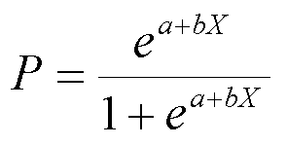

Methods
Logistic Regression
Random Forest Classification

Slide 10
Project Description
Data collection and cleaning
Drop unnecessary columns
Create country based on gameId and assign region according to Riot Games API
Convert NaN and Null values to 0
What is the target feature?
Based on the target what would be the best model for prediction?
Logistic Regression / Linear Regression
SVC
Random Forest Classification
Feature Selection
Why does this matter
Regression scores with top features picked
Results
Conclusion
*Please add slides as required.

Slide 11
Data Collection
Data collection and cleaning
Many of the features dropped are all user descriptions and not useful to the outcome of the project.
The country column was added in, the data was taken from a gameID column that consisted of a code format cc-#### where cc is a country code and an incremental number that pertained to a match id. The country was stripped from the first two characters and assigned an arbitrary number from 1 to 9 dependent on what country it was
The region column was also added in. The Riot API endpoints let a developer know what countries are in which regions, with only 3 regions, another arbitrary number was added from 1-3 to its related country number.

Slide 12
Data Organization
Region
Three regions: Americas, Europe, Asia
Country
9 discernable countries: Korea, Europe, Americas, Brazil, Turkey, Oceanic Regions, Japan, Latin Americas, Russia
Lanes
Top, Jungle, Middle, ADC, Support

Slide 13
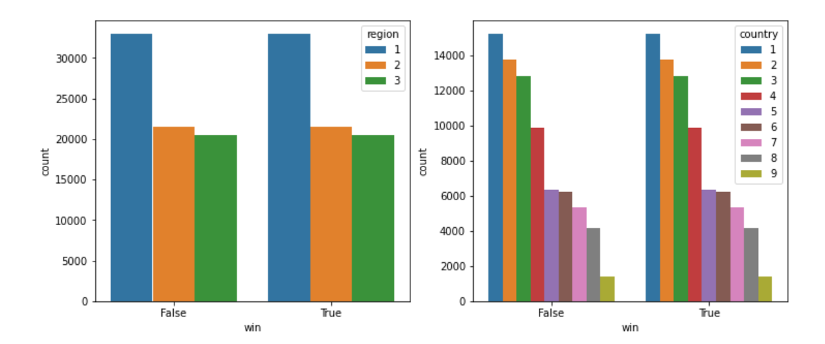
Target Feature
The feature this study aims to predict is the ‘win’ feature.
An interesting note comes from this, since it is a Boolean value. The dataset is perfectly split between all countries and regions giving a perfectly balanced dataset.

Slide 14
Models
Since the target feature is a Boolean value, the best models for prediction are:
Logistic Regression
Random Forest Classification
Reasoning:
Logistic Regression is used to predict the likelihood of an event given one or more explained variables. Since we are predicting win/loss this is a perfect application for this model.
Random Forest because of its randomness in selecting subsets of data for the tree nodes, RFC is an amazing tool for feature selection. This will allow us to find where among the other features the origin lies.

Slide 15
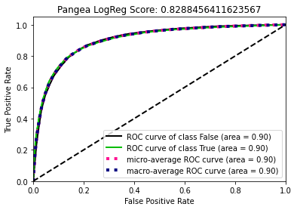
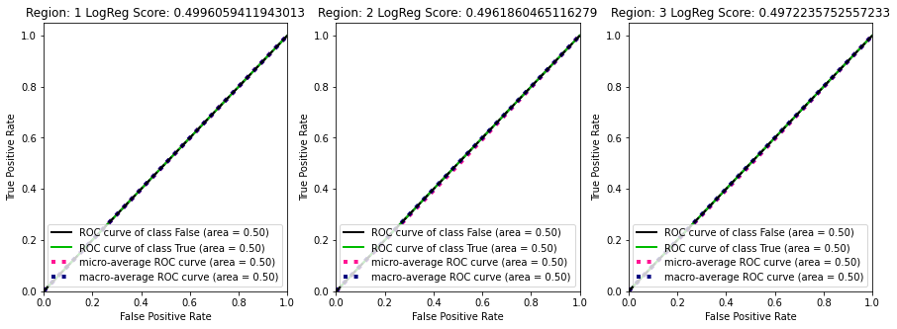
Pangea and Region ROC

Slide 16
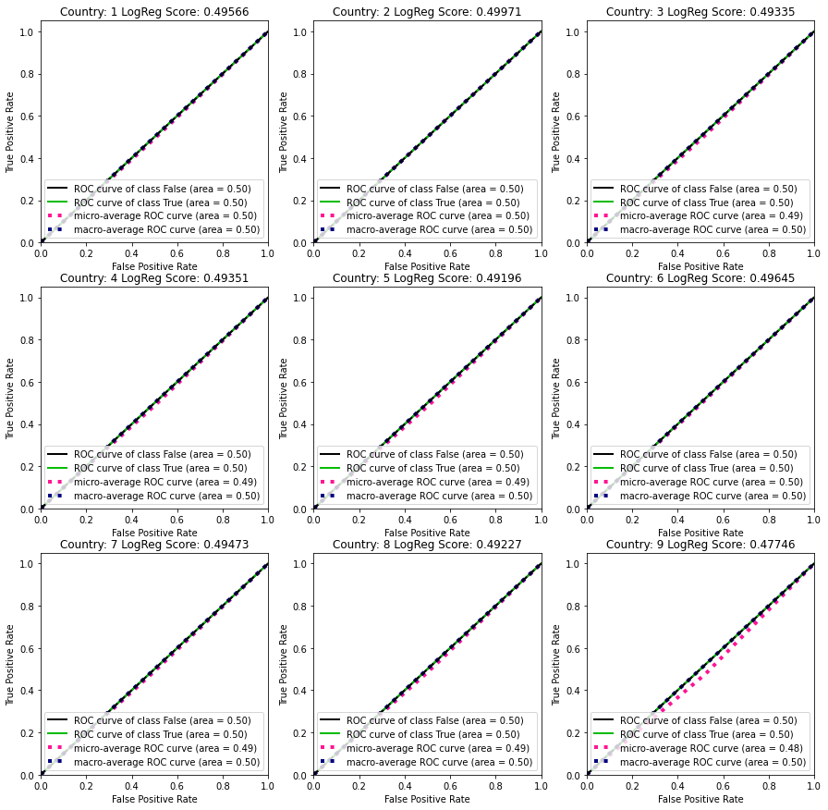
Country ROC Graphs

Slide 17
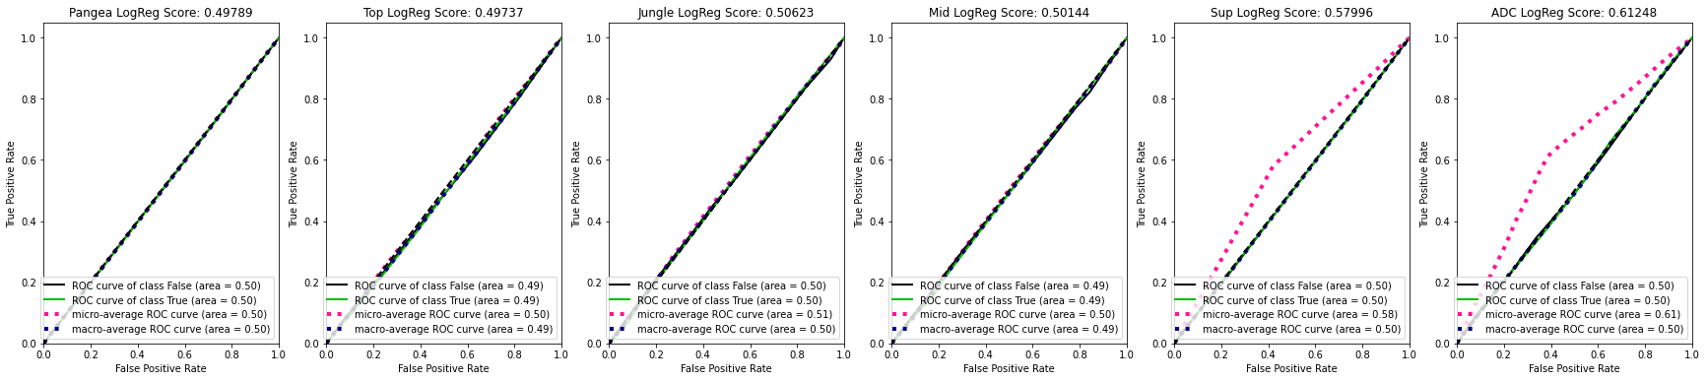
Lane Country and Region ROC

Slide 18
Feature Selection pt.1
Recognizing that country and region are not suitable features to base a model on a new one needs to be created. This time an Random Forest Classifier is fit to each region and the over encompassing dataset. From these models the most important features can be found:

Slide 19
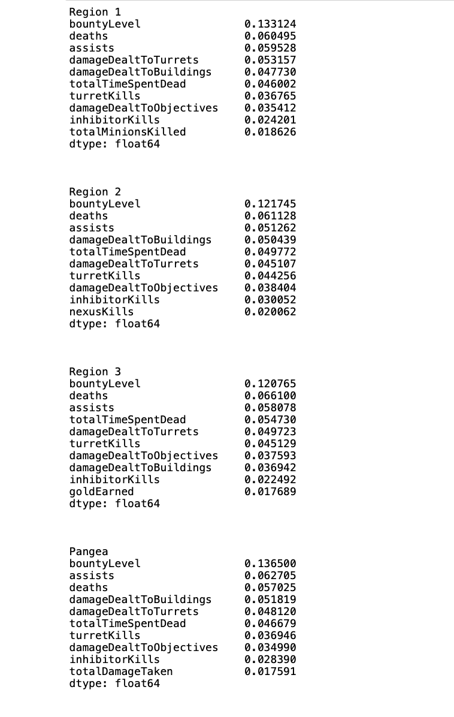
Feature Selection pt.2

Slide 20
Analysis
From the features that were given back, the top 10 of all of them where chosen to create two new models. One that contains the new set plus country and region and another without them.
*Please add slides as required.

Slide 21
Analysis and Results
With two new models we can see that the presence and absence of an origin has an insignificant effect on the outcome of a model. The mean score of cross validation is separated by .03 when you remove the country and region
*Please add slides as required.

Slide 22
Conclusion
With the analysis completed, the country and region of a team is not a significant enough factor in its ability to win. Although the origin is insignificant, the separation of regions provides evidence of different regional playstyles.
From this study we learned that country and region are not significant to the success of a team. But it does change what is important and what should be focused on.
A new direction to look at that could expand this study would be to find low importance features that have heavy influence on higher tiered features. Attempting to fit a linear regression to smaller features to predict more important ones could potentially give a stronger more ‘real time’ type of analysis that could significantly affect the training process of a team.
*Please add slides as required.

